Slide 1
Presentation skills

Slide 2

Who is afraid of Public Speaking?

Slide 3
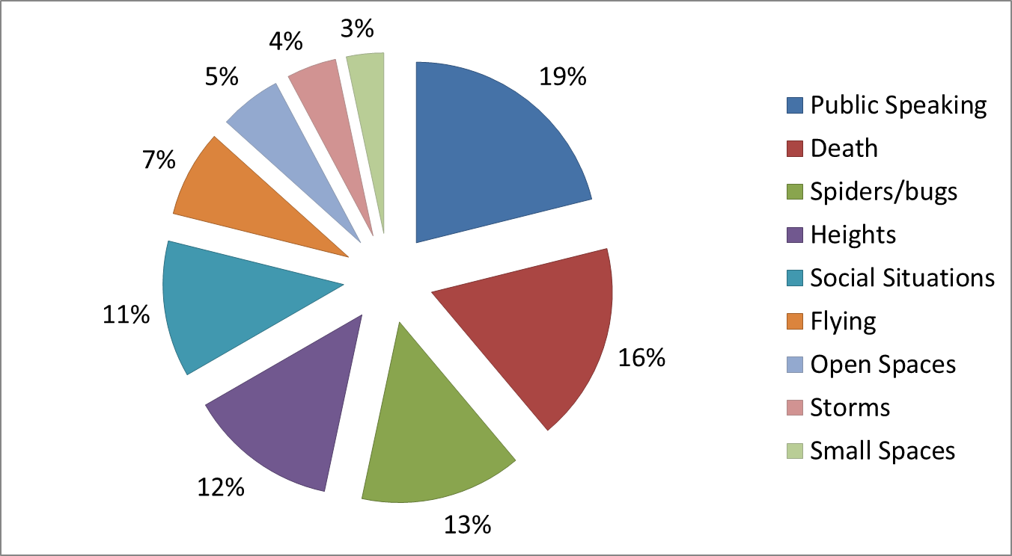
Top 10 Global Fears

Slide 4
What is a Presentation?
“A structured, prepared and speech-based means of communicating information, or ideas to a group of interested people, in order to inform or persuade them.’’

Slide 5

A presentation is a means of communication which can be adapted to various speaking situations, such as talking to a group, addressing a meeting or briefing a team.

Slide 6
Why Presentation Skills
Training?

Slide 7
Why Presentation Skills
Training?
To properly Structure your presentation.
To overcome nervousness.
To develop powerful body Language.
To deliver effective presentation.
To learn what not to do during presentation.
To design and use visual aids effectively.

Slide 8
Public speaking is considered the number one fear of most people
People are caught in the crossfire between their fear and the fact that many employers expect them to demonstrate good verbal communication skills
Most interviews by PhD’s have a presentation component
Academic interviews always have a presentation/chalk talk

Slide 9
Boring presentation?

Slide 10
Common causes of Ineffective Presentation

Slide 11

Common causes of Ineffective
Presentation
Failure to motivate the audience
Confusing structure
Execessive details
Poorly designed
slides

Slide 12
“Great speakers aren’t born, they are trained.”
Presenting is a Skill…
Developed through experience
and training.

Slide 13

Steps needed to make an Effective Presentation
For delivering an effective presentation we need to take the following steps:
1. Planning
2. Preparation
3. Delivery

Slide 14

Planning

Slide 15

Planning
What is the purpose of your presentation?
Who is your audience?
Why are they there?
What is your goal?
How long will it be?
Where will it take place?

Slide 16
Planning cont...
Design your message
Organize your material
Design the look of your presentation
Create the slides.
The following steps need follow to plan a presentation effectively.

Slide 17
Step -1: List your objectives
Why are you making this
presentation?
What do you expect to
accomplish?

Slide 18
Step -2: Focus on the audience
Who are they?
Focus on what your audience needs
to know, NOT- what you know.
Consider audience’s level & interest
Decide what you want the audience to
do, as a result of your presentation
Size of audience and location may influence the presentation

Slide 19
Step -3: Determine the message
Tailor the points to the audience’s
technical level: information needs
and interest.
Modify the presentation for each
new audience

Slide 20

Preparation

Slide 21
Preparation
1. Subject of presentation:
a) Decide your message in advance
b) Have a strong conviction on what
you want to talk.

Slide 22
Preparation
2.Structure
Write your presentation in this order:
Objective
Beginning or introduction
Main content
Summary, conclusion and recommendations
Questions

Slide 23
Preparation
Introduction
Grab the audience attention
Main theme
content should be relevant to topic
Key message
summary/
Conclusion

Slide 24
Preparation
3. Rehearse in private:
You need to practice delivery of presentation.
Because, ’Practice makes a person perfect’.

Slide 25



Rehearse all points what you prepare.
Rehearse with all visual aids and handouts.
Practice again and again to manage time.
Rehearse in front of mirror or a friend

Slide 26
Preparation
4. Keep notes to a minimum:
-If necessary, use Index Cards.
-Jot down the main points

Slide 27
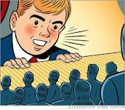
5.Conquer Nervousness

Slide 28
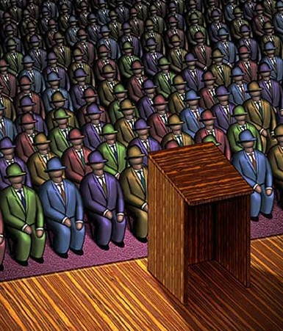
Don’t Be Afraid
Sometimes an
audience may seem
intimidating
But always remember
they are also people
like you.
* Imagine that you are addressing your friends

Slide 29
Preparation
Try to conquer nervousness:
* Try to minimize your
stage-fear.
Take deep breath and try to relax.
If required, drink little water.

Slide 30

Preparation
6.Concentrate on topic &
not the audience.
Remember-” Winners
continue, losers stop.”

Slide 31



Preparation material
You can use following items to make the content of your presentation:
Handouts
Personal notes
Internet
Visual aids

Slide 32
The Delivery

Slide 33
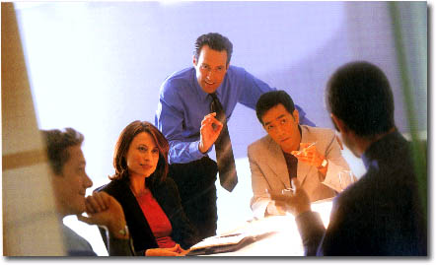
The Delivery
The Eyes
The Voice
Expression
The Body

Slide 34
Organizing your Delivery- The Opener
”Tell them what you are going to tell them”
- Set the tone
- Capture your
audience’s attention
- Build rapport
- Tailor your opener to your
audience

Slide 35
The Opener
Introduction:
a) Start with a bang to get
attention.
Start with an ice-breaker such
as a story, joke or a quotation.

Slide 36

The Opener
b) Be warm and friendly
c) Provide facts & figures
d) Throw out a question

Slide 37
Organizing The Delivery (Middle)
Say it
- Organize the
presentation around
main aspects of the
subject.

Slide 38

Body Language during presentation
SMILE
Make Eye-Contact
Do not lock your arms
Knees unlocked, head up,
Move
Connect with the audience
Breathe & Relax

Slide 39
Eyes
Look at audience’s faces, not above their heads
If an interview or business meeting…look at the decision makers as well as everyone else
Vary where and who you look at
Look at faces for 3-5 seconds and then move on to the next person
Do not look away from audience for more than 10 seconds
Looking at a person keeps them engaged

Slide 40

Voice
Louder and clear than your normal pitch.
Vary pitch and volume.
Use active rather than passive verbs
Avoid technical terms, unless you know the audience is familiar with them
Always use your own words and phrases
Cut out jargon

Slide 41

Appearance
Dark colors read as businesslike.
Wear comfortable shoes to weight your feet evenly.
Allow yourself to move a bit.
Look confident.

Slide 42

Professionals vs. non professionals

Slide 43
Organizing- The Close
”Tell them what you have told them”
- Reiterate the theme
- Summarize message
- Repeat key points
- Ask for action
- End on a positive note

Slide 44
Time yourself for Maximum Impact
Oops! I don’t have much time left!

Slide 45
The Three Presentation Essentials
1.Use Visual Aids, wherever you can
2. Rehearse, Rehearse, & Rehearse
”If you fail to prepare, you are prepared
to fail”
3. Memorize your script

Slide 46
Design the ”Look” of your Presentation
Follow the ’KISS’ rule – Keep it
Short and Simple
Use short words and short phrases
The 6 x 7 rules:
- Not more than 7 words per line
- no more than 6 lines per slide

Slide 47
Why Visuals?
Visuals are powerful
tools because they:
- increase understanding
- Save time
- Enhance attention
- Help control nervousness

Slide 48

Tips on Visual Aids
Are the Visual Aids
easy to read and easy
to understand?
Can they be easily seen
from all areas of the
room?

Slide 49
Tips & Techniques for delivery
1. I’ll Say It Again - Rehearse
Just do it. Again and again. Experiment with pauses, gestures, and body language. Practice around one hour for every minute of your speech.
2. Practice With a Timer
Consistency is key to an effective PowerPoint presentation. Timing should be similar (ideally the same) each time you rehearse. This one will especially pay off when it’s time to present in front of your audience!

Slide 50
Tips & Techniques for delivery
3. Slow It Down
Many of the best speakers today intentionally speak slowly. You’ll have the chance to emphasize, appear more thoughtful, and make your information easier to digest.
4. Pause More Often
Like the prior tip. Pausing more often, allows main points to be emphasized and for information to sink in. You need to let key points breathe a little before rushing into the next section.

Slide 51
Tips & Techniques for delivery
5. Record Yourself
Use your phone’s voice recorder. Assess and critique yourself. Consider:
Are your pauses too short or too long?
Are you speaking slowly enough? Too slow?
When you’re nervous does your voice get high like the mice in Cinderella?

Slide 52
Tips & Techniques for delivery
6. Do not put both hands in your pockets for a long time
7. Speak to the audience, not to the visuals
8. Discuss your objectives at the beginning of the presentation

Slide 53
“Make sure you have finished speaking before your audience has finished listening.”
-Dorothy Sarnoff

Slide 54
Thank You

